Slide 1
Analysis of Democratic Presidential Candidates
Drazen Zack

Slide 2
2020 candidates examined
Cory Booker
Senator (New Jersey)
Kamala Harris
Senator (California)
Amy Klobuchar
Senator (Minnesota)
Bernie Sanders
Senator (Vermont)
Elizabeth Warren
Senator (Massachusetts)

Slide 3
What & how we Analyzed
Tweets about Candidates
From Apr 4 – Apr 11
Common words (Single & Paired)
Sentiment
Personal Twitter Accounts
From Nov 1, 2018 – Mar 31, 2018
Number of tweets by Month & Day of the Week
Sentiment
Paired Common Words

Slide 4
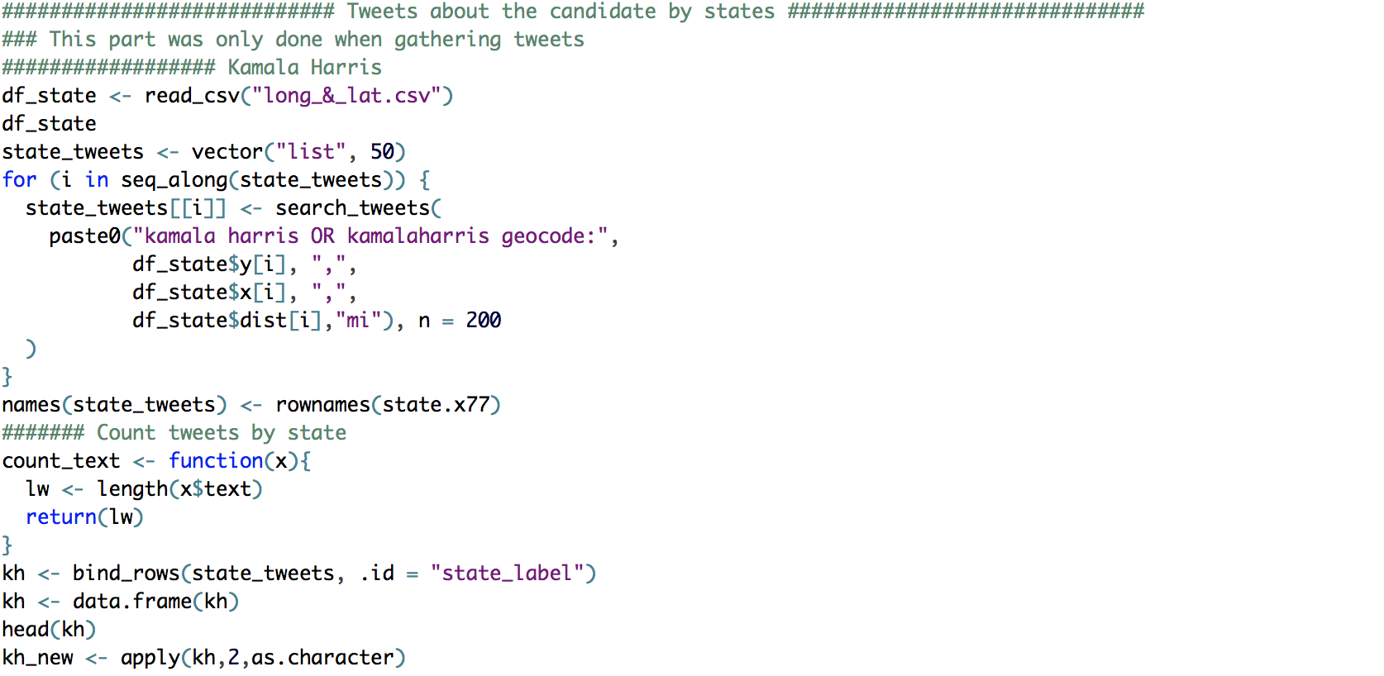
Gathering Tweets
Tweets about Candidates
“search_tweet” from rtweet package
Created csv with center of each state geocode
Radius need to cover state in miles

Slide 5
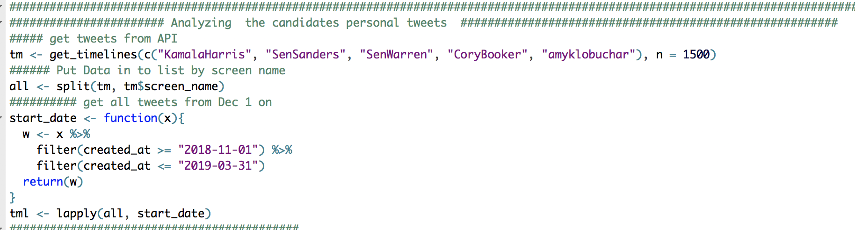
Gathering Tweets
Personal Twitter Account
“get_timelines” from rtweet package
Gathered last 15000
Filter from Nov 1, 2018 to Mar 31, 2019

Slide 6
Tweets about Candidate
From Apr 4 – Apr 11

Slide 7
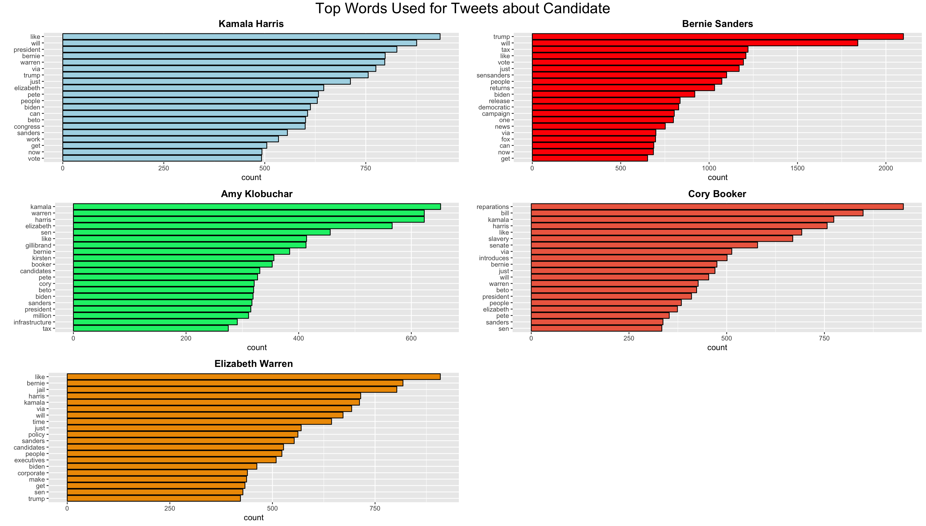
Common Words
Packages Used:
tm
ggplot2

Slide 8
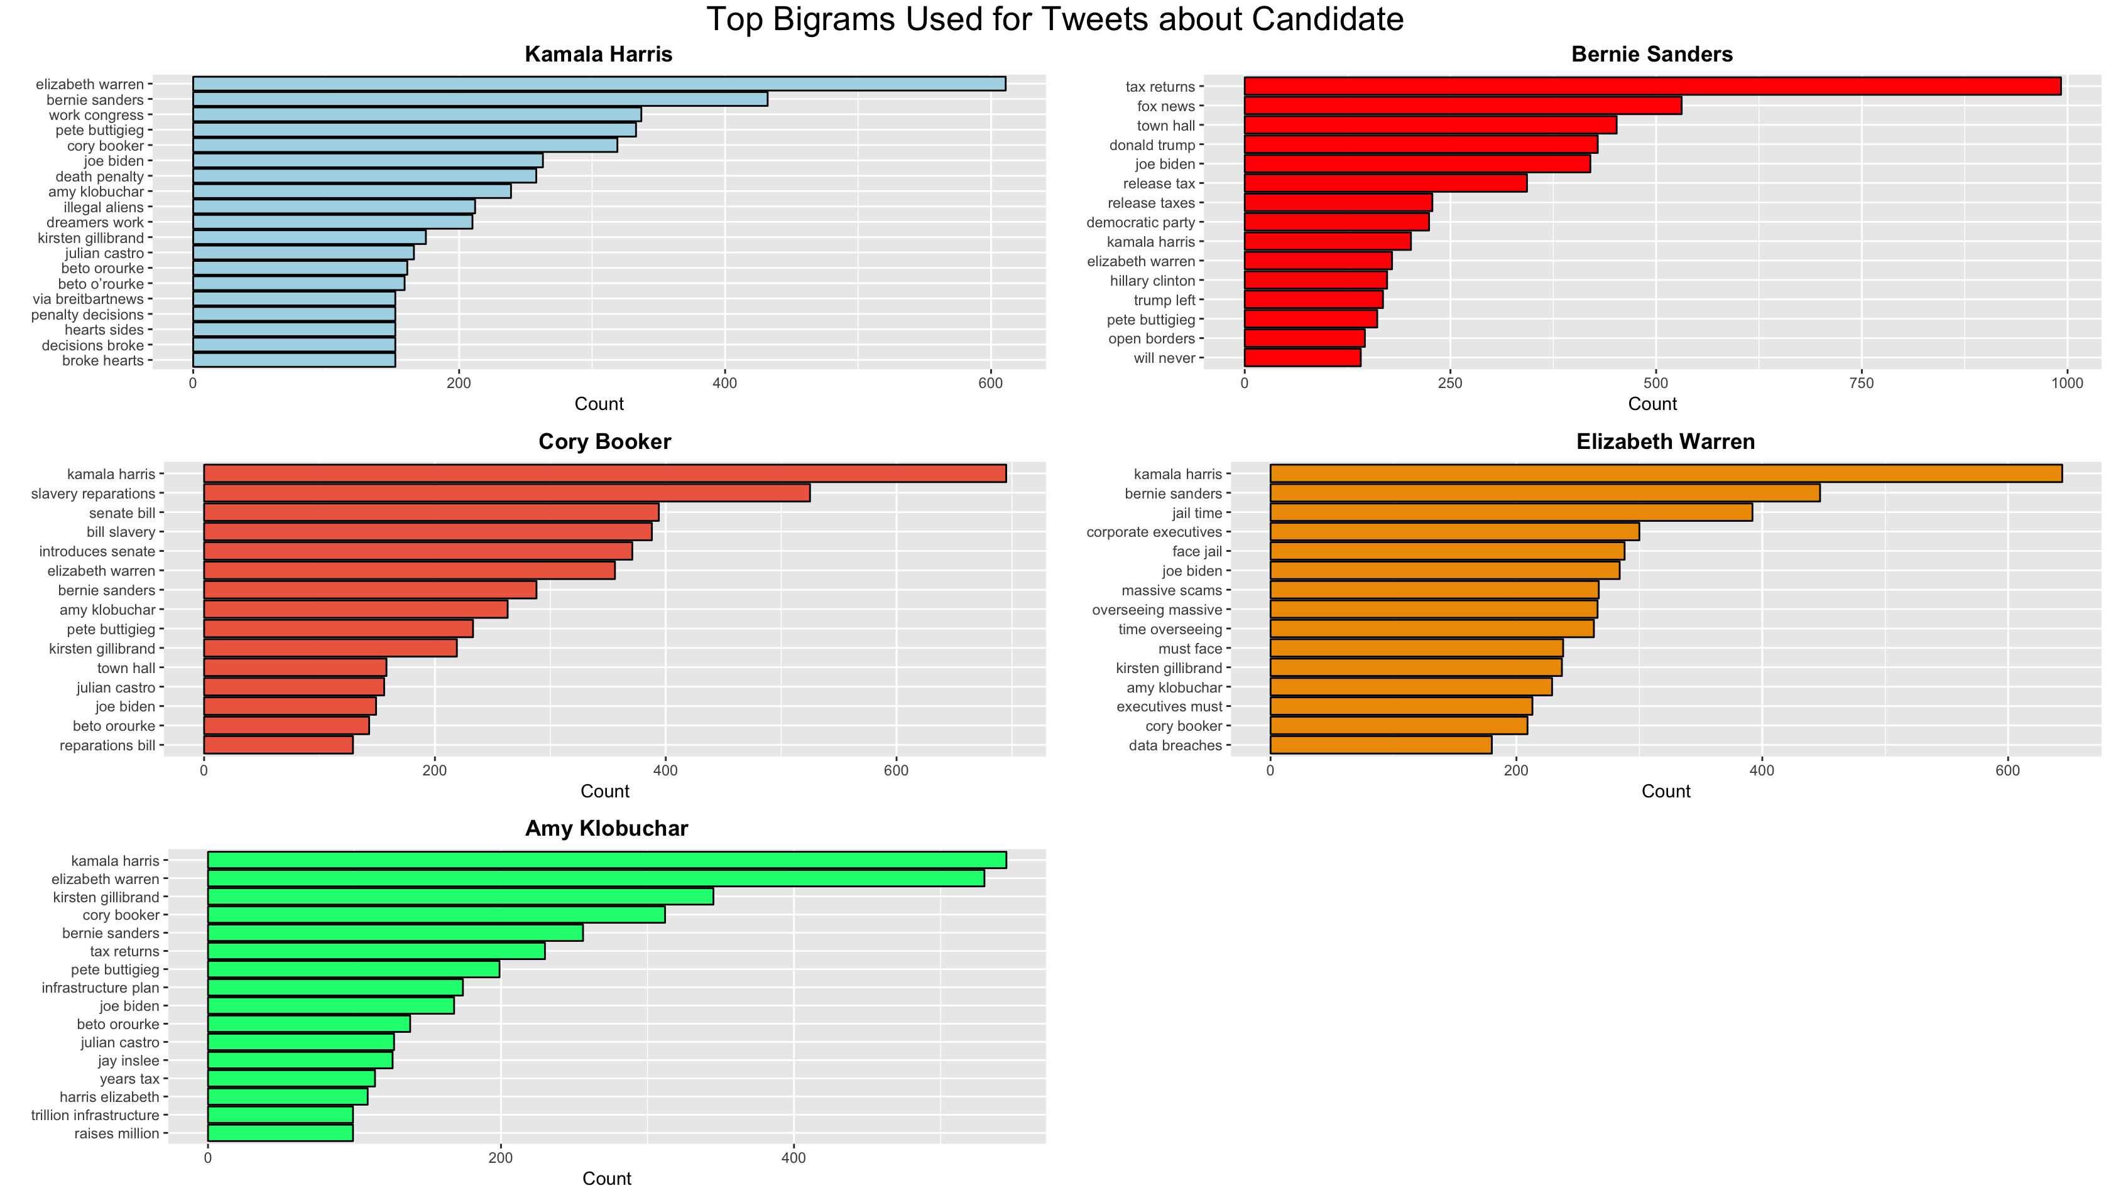
Common paired Words
Packages used:
ggplot
tidytext

Slide 9
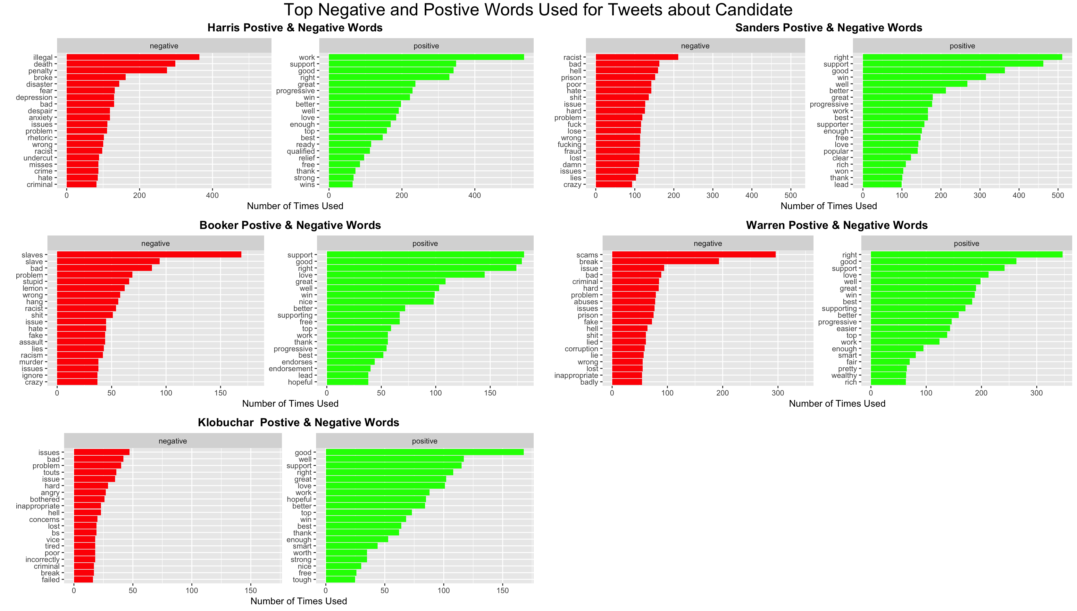
Top Positive & negative words
Packages used:
tidytext
bing lexicon
ggplot

Slide 10
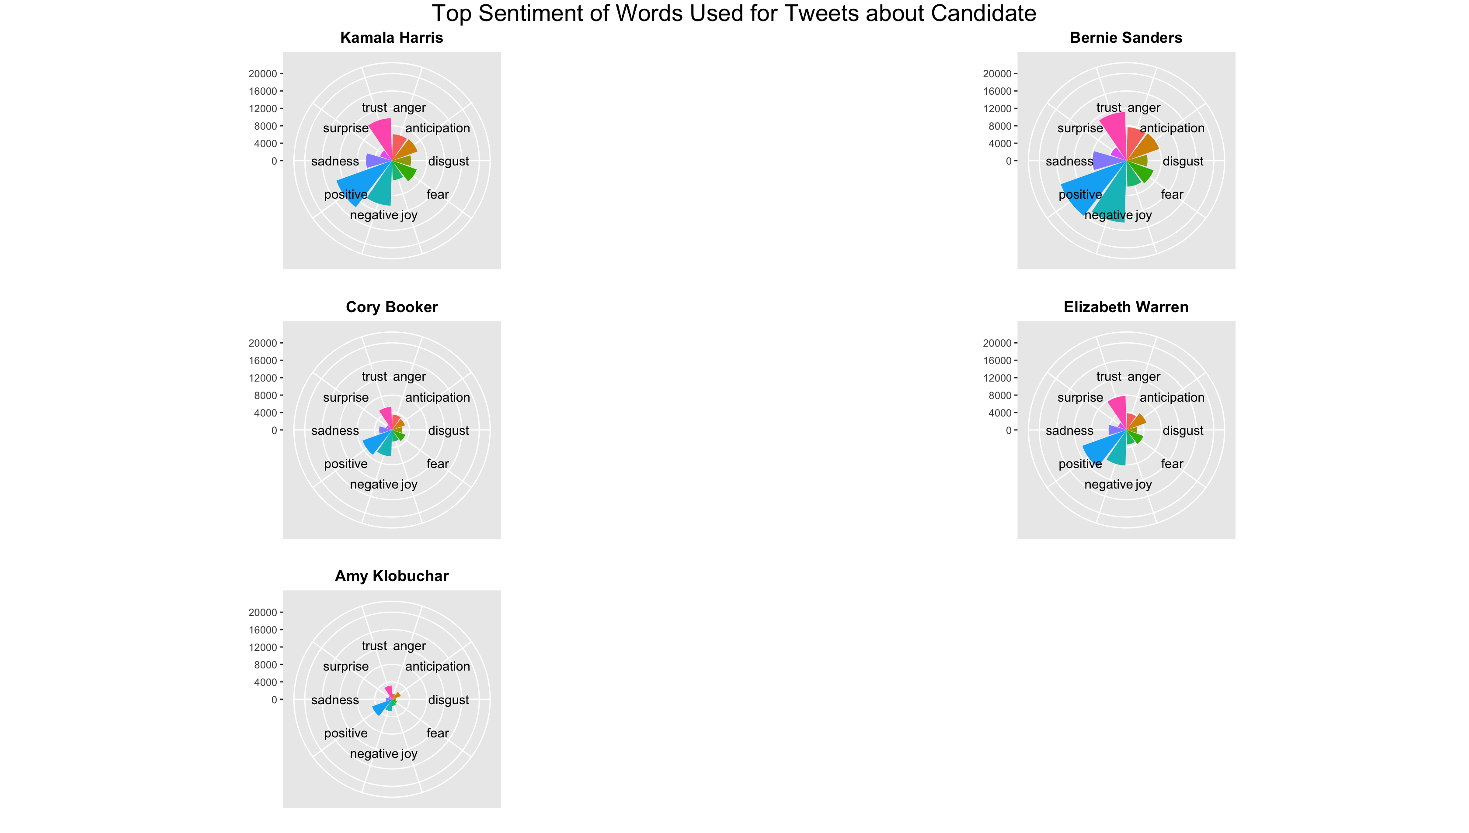
Sentiment
Packages used:
tidytext
nrc lexicon
ggplot

Slide 11
Discussion of tweets about Candidate
Cory Booker
Slavery related themes
Kamala Harris
Name is common in other candidates tweets
Amy Klobuchar
Not Progressive
Bernie Sanders
Mentioned with Trump
Elizabeth Warren
Jail time

Slide 12
Personal Twitter Account
From Nov 1, 2018 to Mar 31, 2019

Slide 13
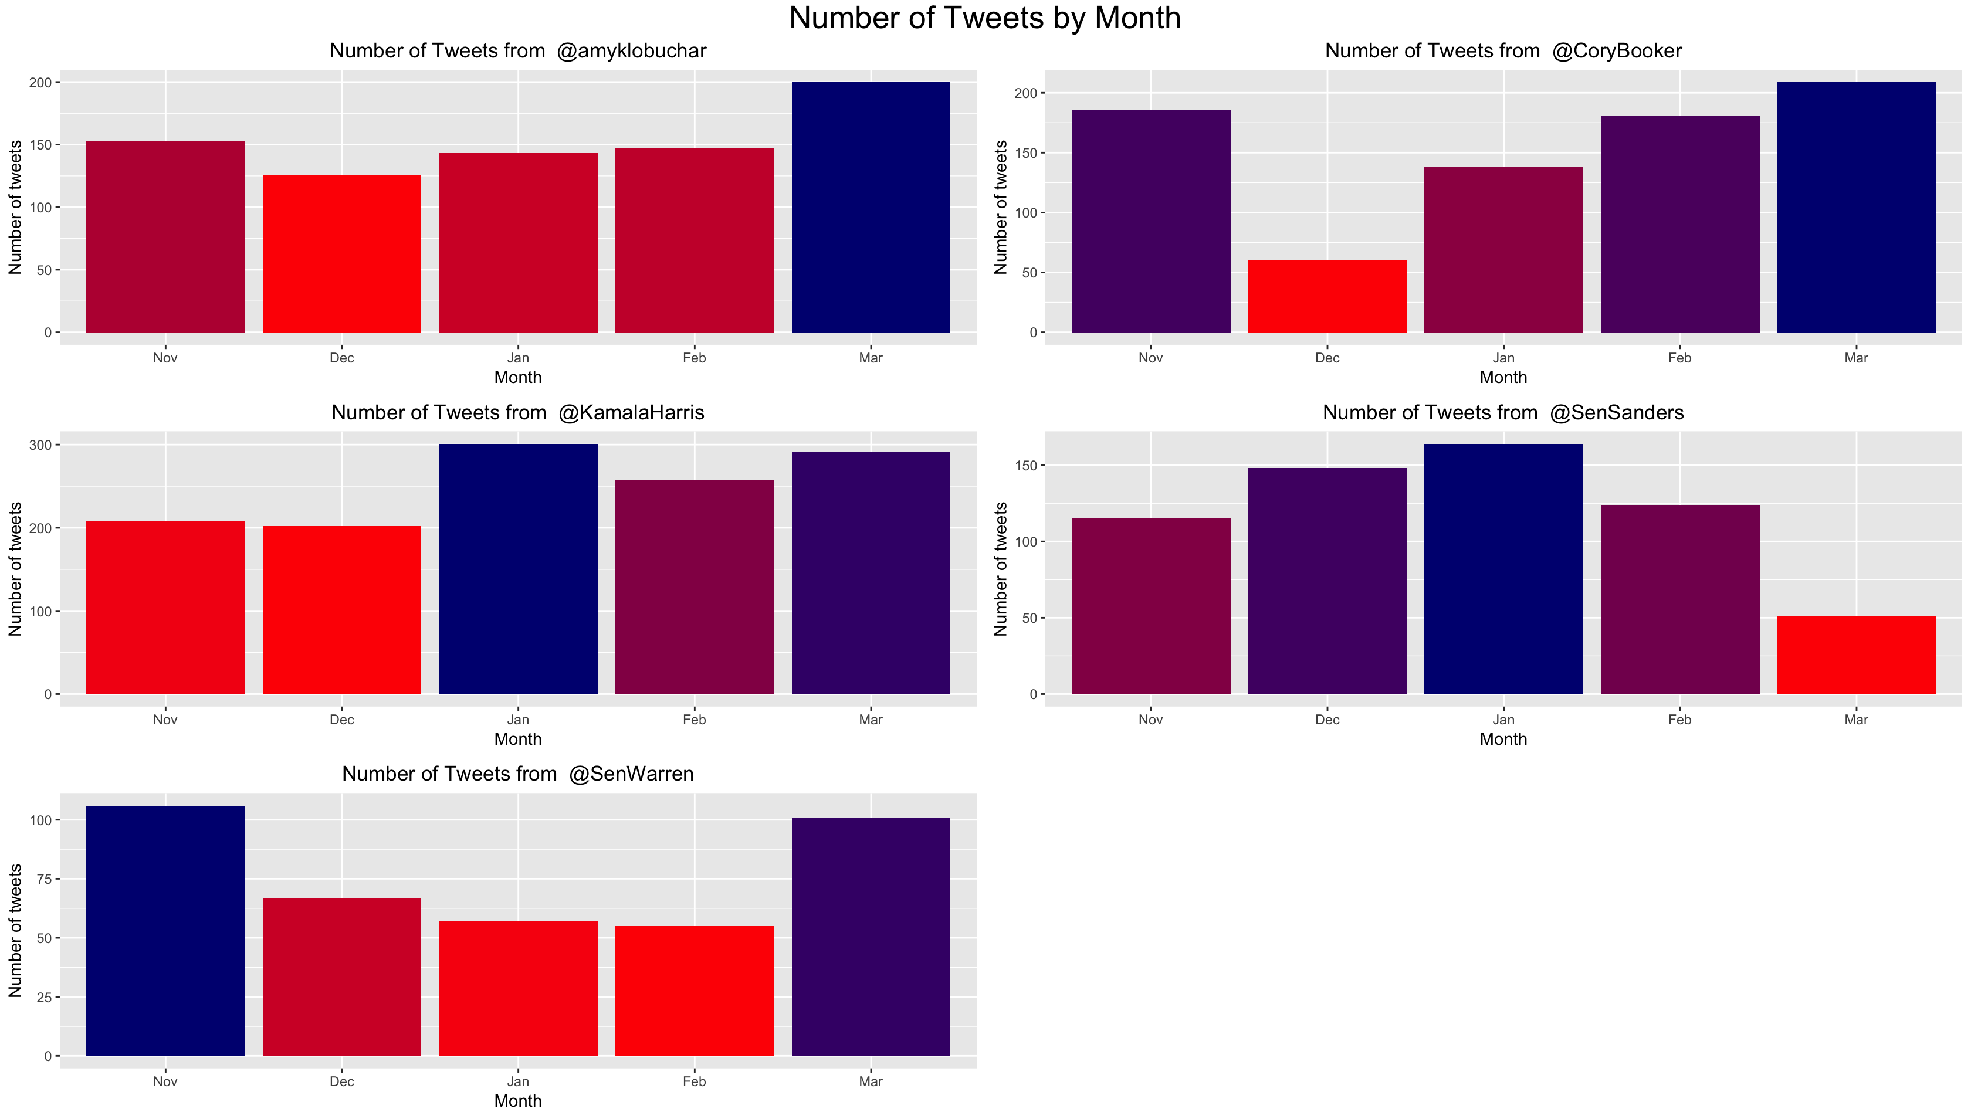
Tweets by Month
Packages used:
ggplot

Slide 14
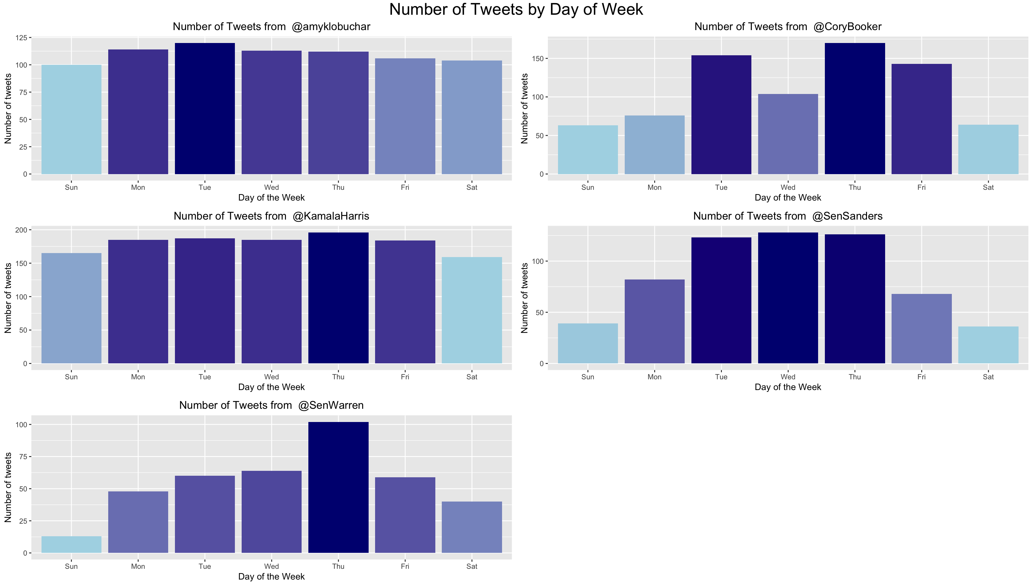
Tweets by Day of the Week
Packages used:
ggplot

Slide 15
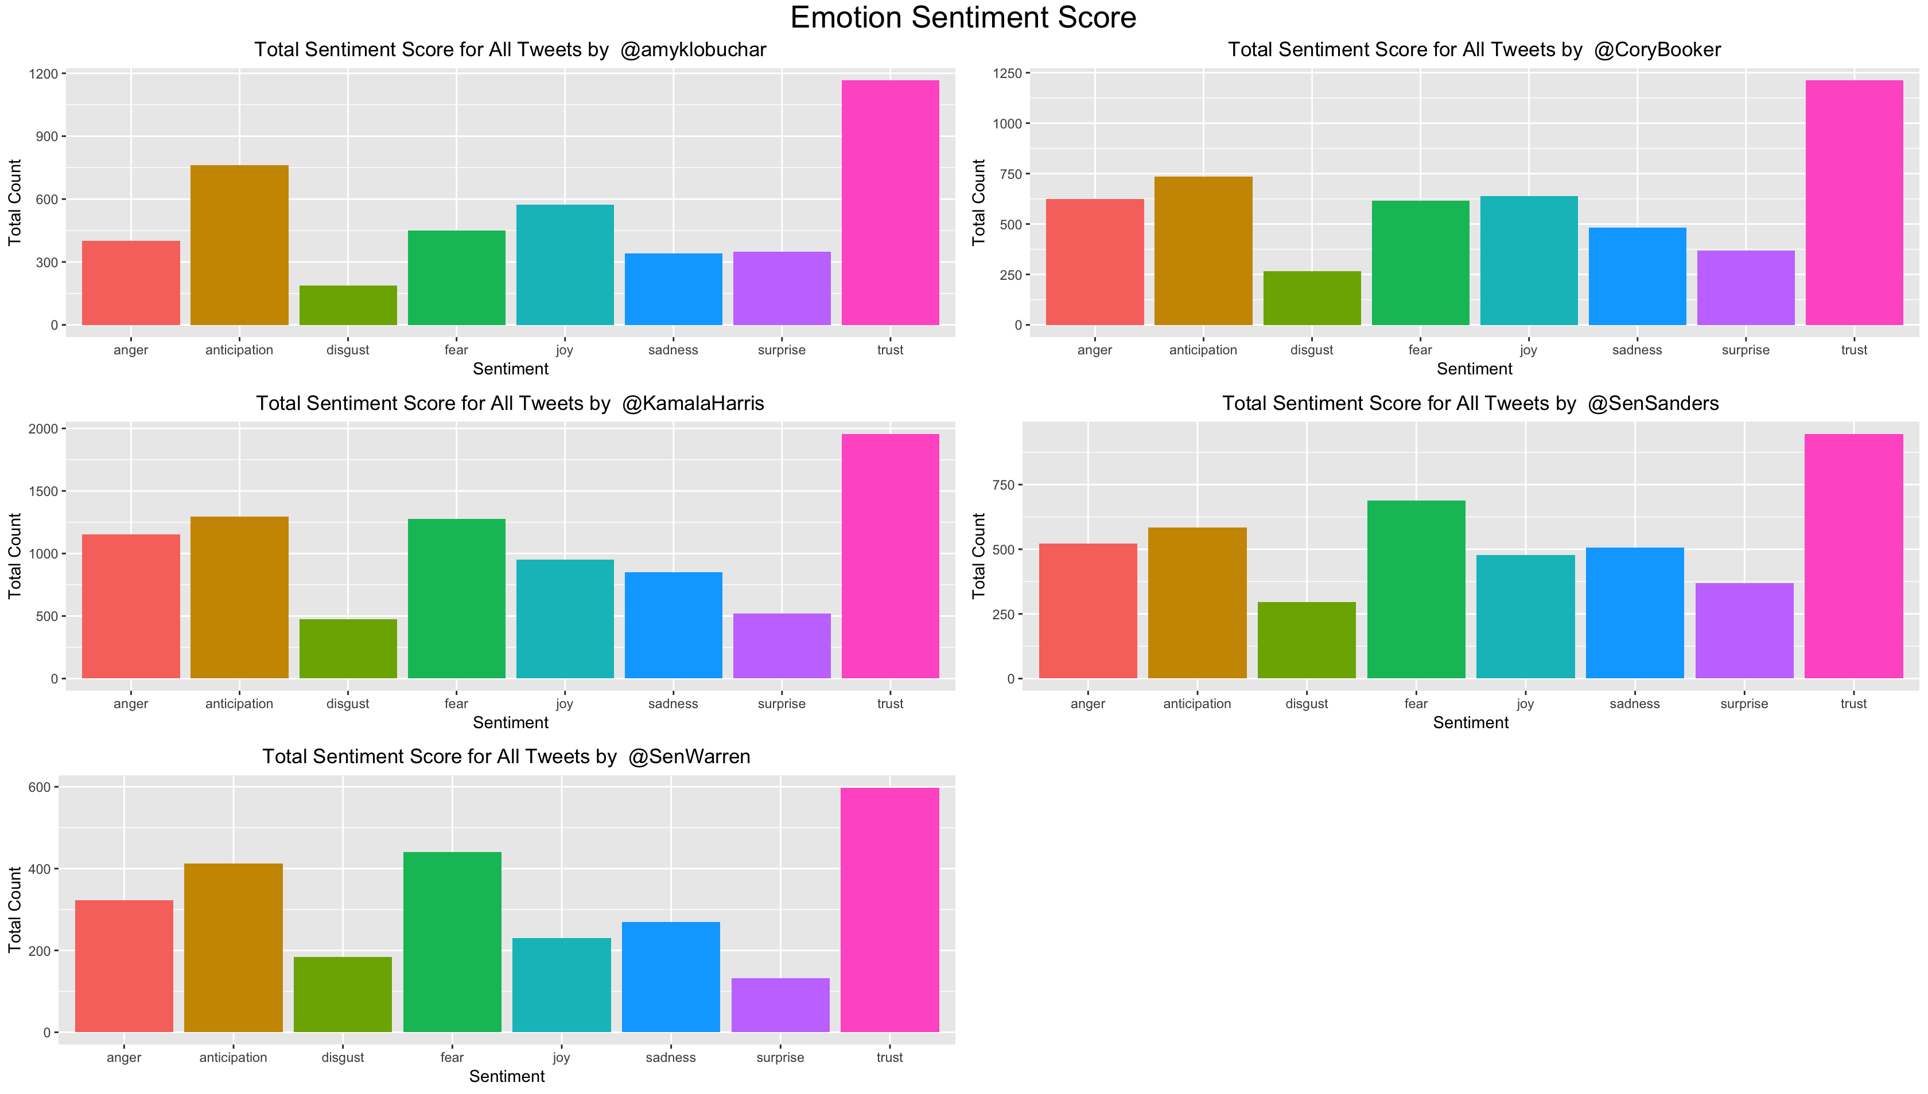
Emotion Sentiment
Packages used:
ggplot
Syuzhet
nrc lexicon

Slide 16
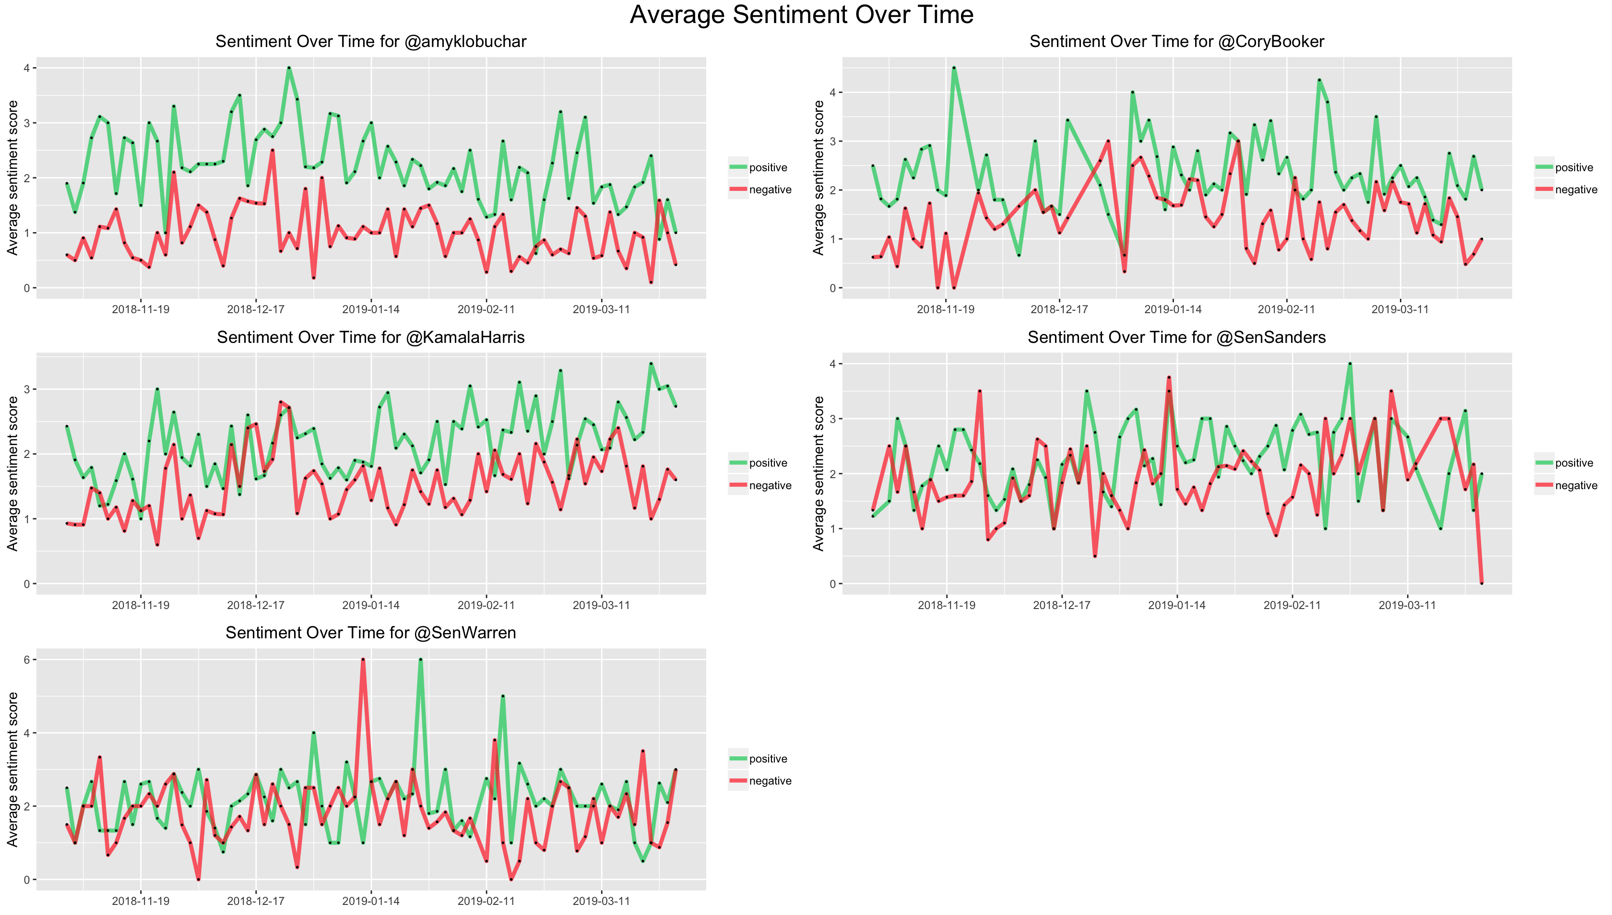
Positive & Negative Sentiment
Packages used:
ggplot
Syuzhet
nrc lexicon

Slide 17
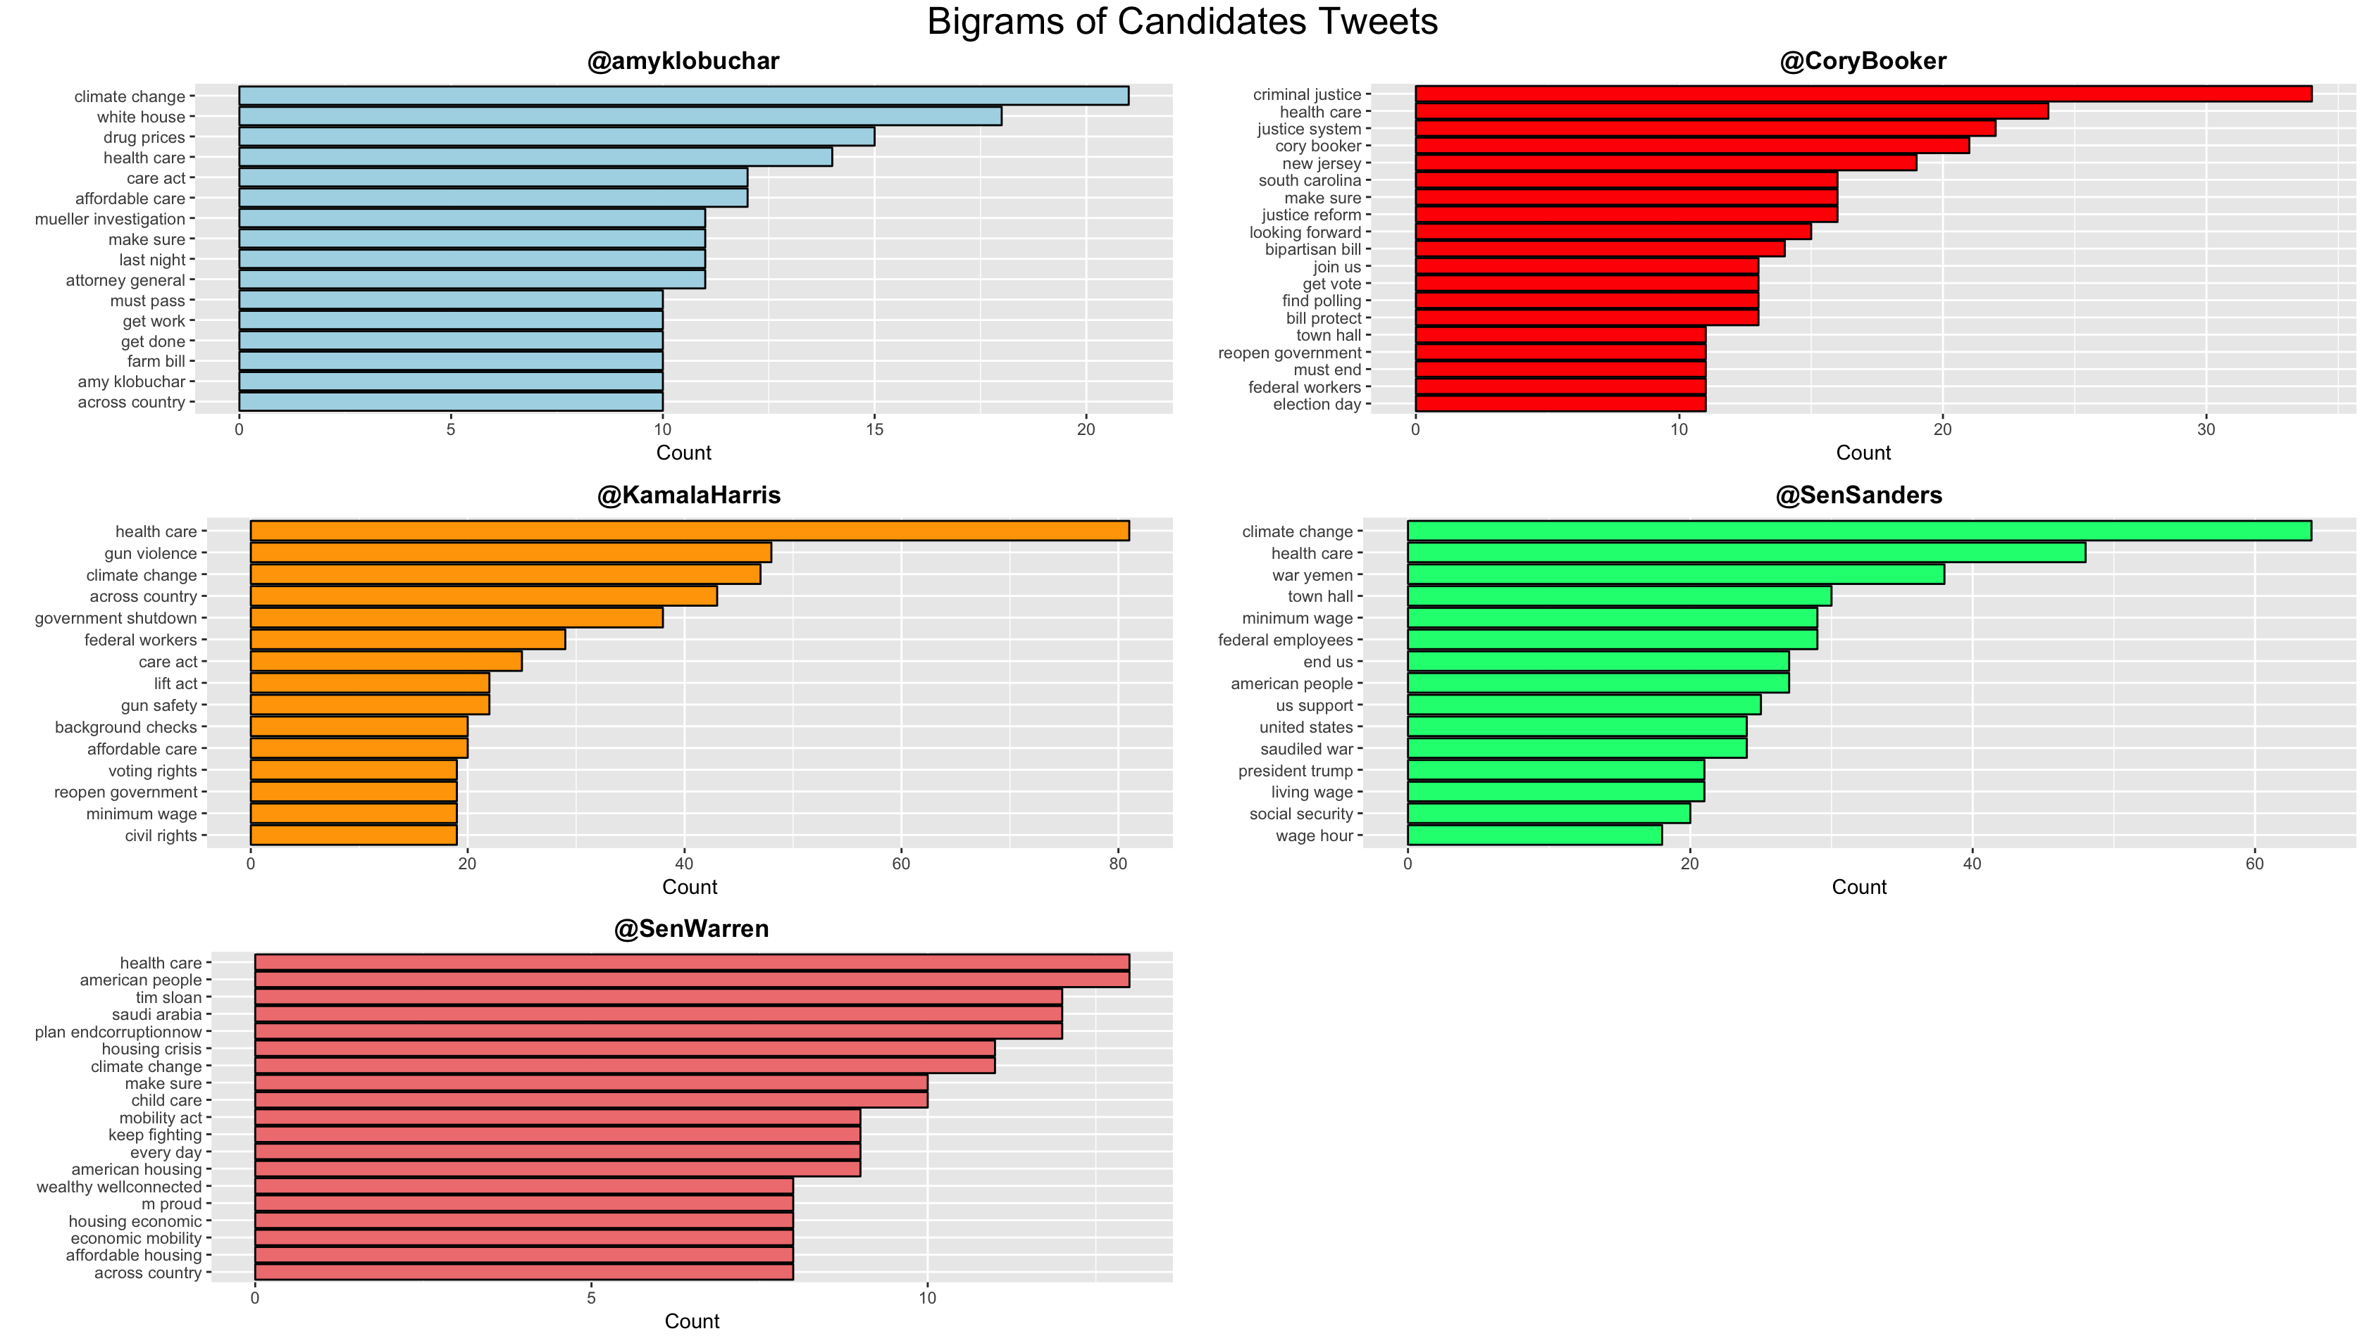
Common Paired Words
Packages used:
ggplot
tm

Slide 18
Discussion of Personal Twitter Account
Cory Booker
Positive
Justice Reform
Kamala Harris
Positive
Health Care
Elizabeth Warren
More negative and fear
Tweet less
Bernie Sanders
More negative and fear
Tweets less
Climate Change
Amy Klobuchar
Positive
Climate Change

